Slide 1
Chongqing University of Technology
ATAI
Advanced Technique of Artificial Intelligence
Chongqing University of Technology
MENTOR: Multi-level Self-supervised Learning for Multimodal Recommendation
Code：https://github.com/Jinfeng-Xu/MENTOR
—— AAAI 2025
Reported by Jing Li

Slide 2
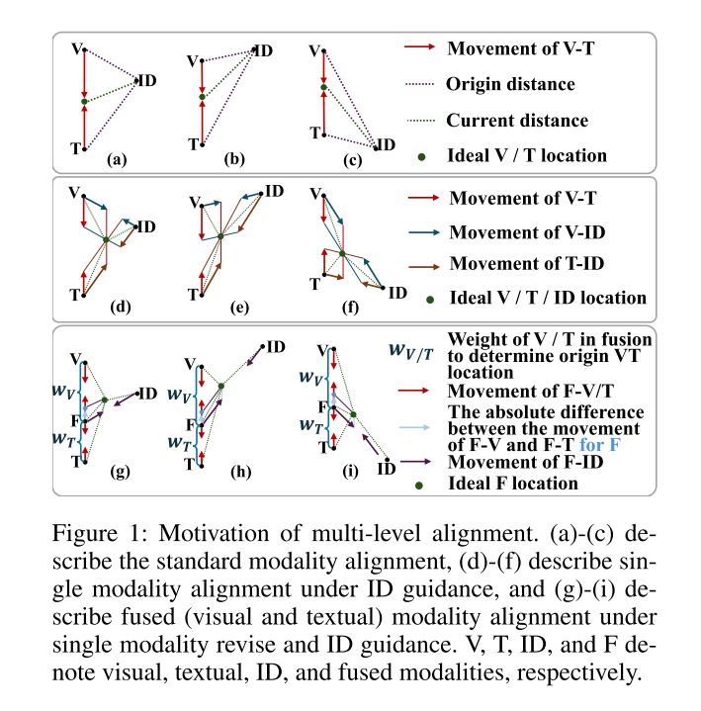
Motivation
1. Previous methods directly align features of different modalities, causing modal information to deviate from ID and lose valuable interaction information.
2. Existing methods directly fuse or align multimodal features, ignoring the incomplete representation caused by data sparsity. The features lack robustness to noise and missing data, and the generalization ability is insufficient, making it difficult to capture stable user preferences in sparse interaction scenarios.

Slide 3
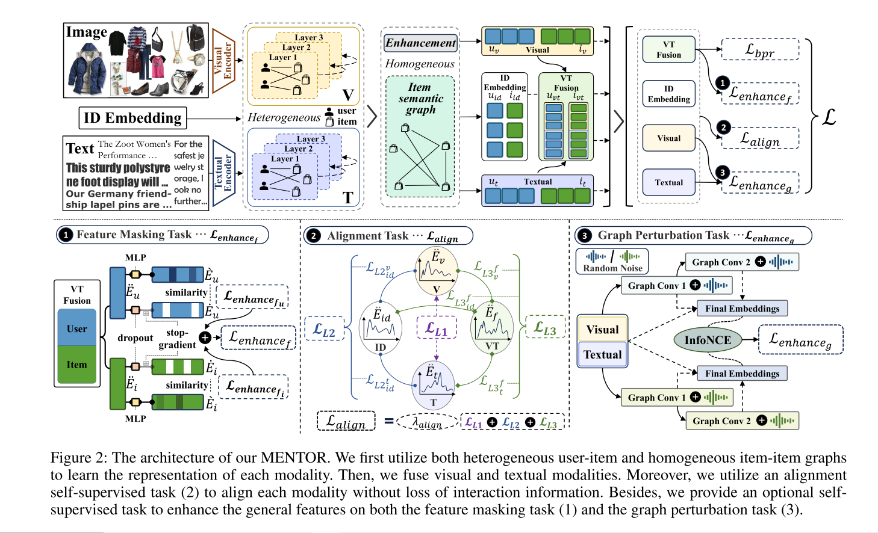
Method

Slide 4
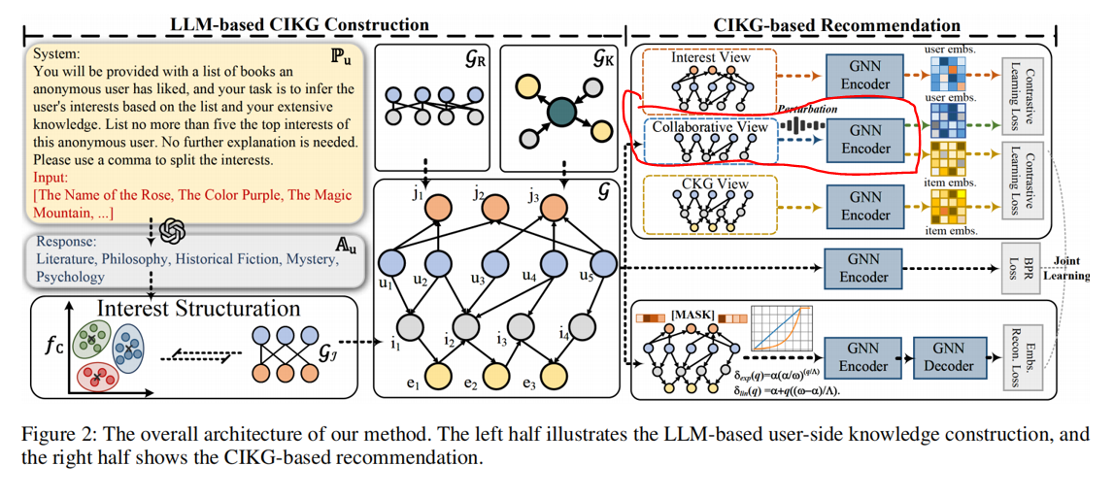
Method
2025_AAAI_Bridging the User-side Knowledge Gap in Knowledge-aware Recommendations with Large Language Models

Slide 5
Method

Slide 6
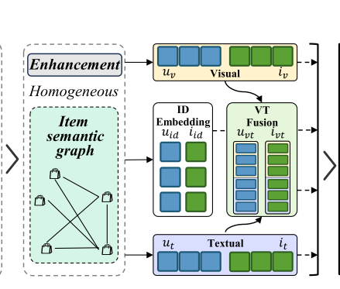
Method

Slide 7
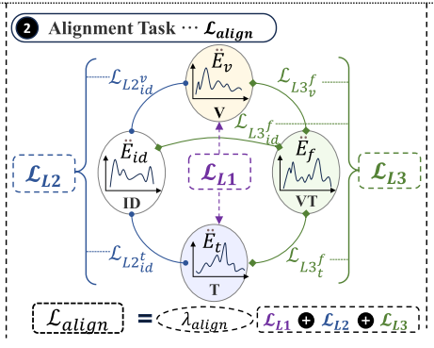
Method

Slide 8
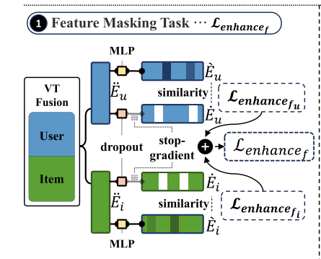
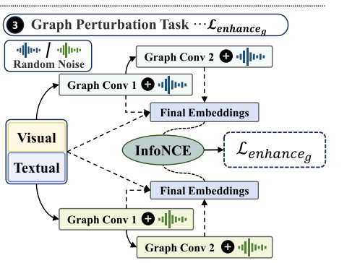
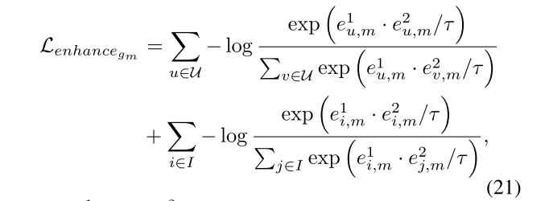
Method

Slide 9
Method

Slide 10
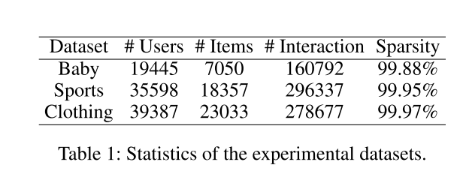
Experiments

Slide 11
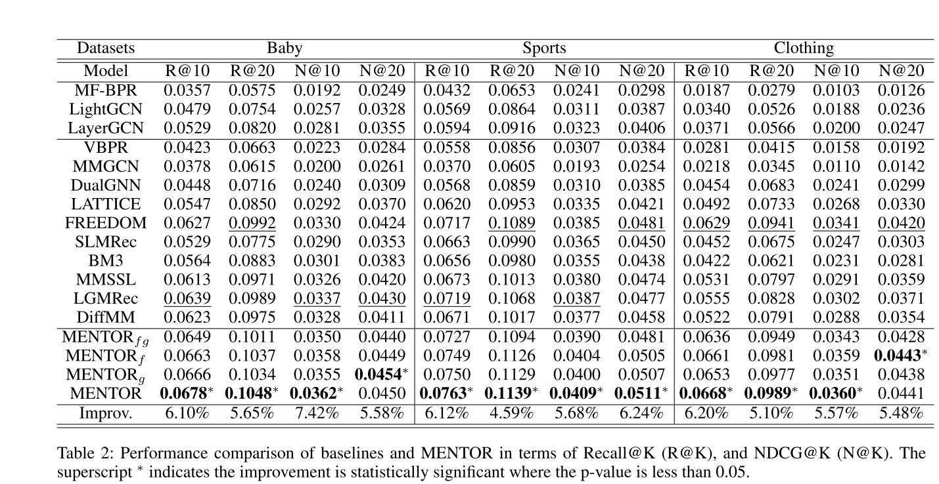
Experiments

Slide 12
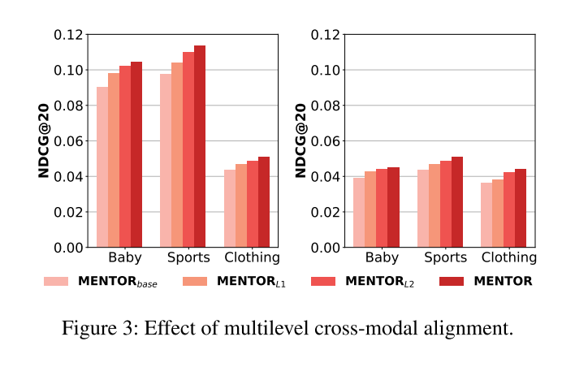
Experiments

Slide 13
Experiments

Slide 14
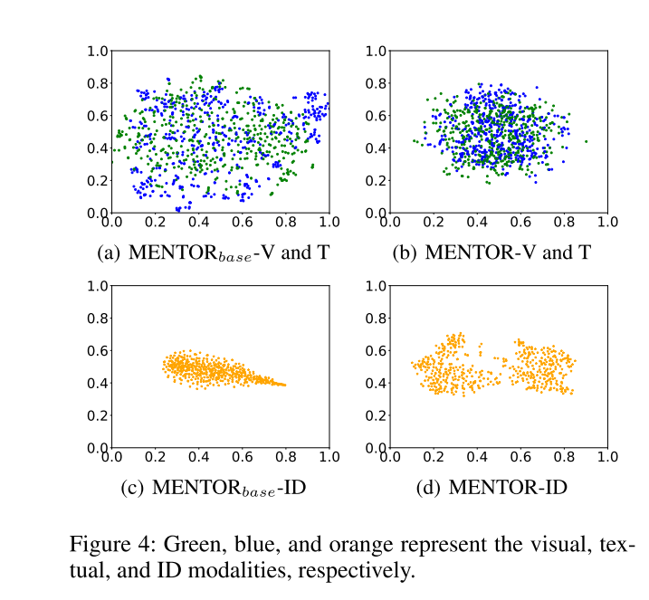
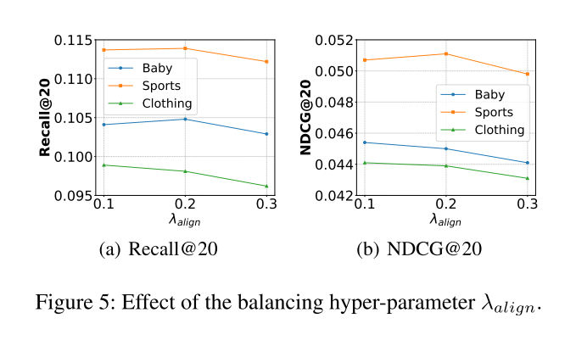
Experiments

Slide 15
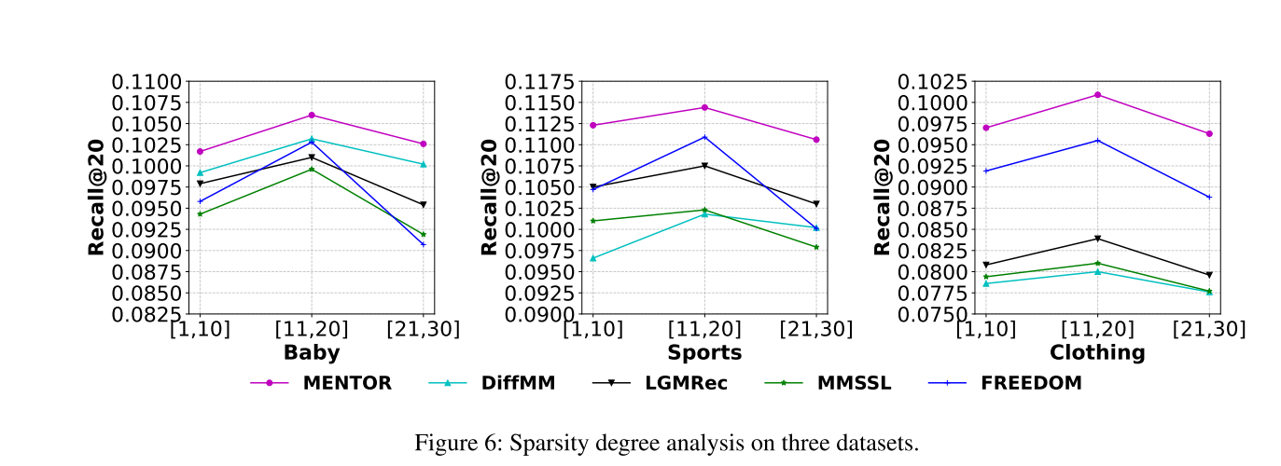
Experiments

Slide 16
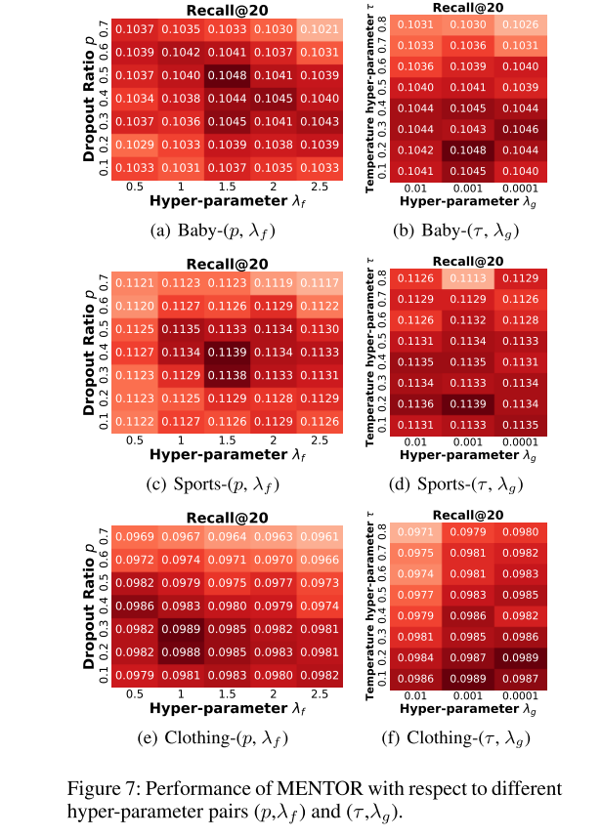
Experiments

Slide 17
Thanks!

